Slide 1


Message Authentication and Digital Signatures
Ms. Swati Mali
swatimali@somaiya.edu
Assistant Professor, Department of Computer Engineering
K. J. Somaiya College of Engineering
Somaiya Vidyavihar University

Slide 2
Message
In cryptography, a message could be
Key- session key, shared key, public, private key etc
Password (salt)
Data –
Files/documents
information,
random numbers for challenge response,
data exchanged for computations like Diffie-Hellman algo,
Seed numbers for key generators and for synchronizations, etc

Slide 3
Authentication
Verification of identity of user or information
Typical authentication methods are based on:
Something you know: a password or personal identification number (PIN);
Something you have: a token, such as bank card;
Something you are: biometrics, such as fingerprints and voice recognition.

Slide 4
Message Authentication
A message is said to be authentic when it is genuine and came from its alleged source.
Message authentication procedures allows communicating parties to verify that received message is authentic.
Important aspects:
To verify that the contents of the message have not been altered
The source is authentic
To verify a message’s timeliness and sequence relative to other messages flowing between two parties.

Slide 5
Authentication mechanisms
Biometrics
challenge response systems
one time password
Passwords
Out of band communication
multi-factor authentication
token based authentication
single sign-on
Kerberos
PKI etc

Slide 6
Entity Authentication mechanisms
1. Knowledge-Based Authentication (KBA)
Passwords
PINs
Security questions
2. Possession-Based Authentication
One-Time Passwords (OTP) (SMS, Email, Authenticator Apps)
Smart Cards
Hardware Tokens (e.g., YubiKey)
3. Biometric Authentication
Fingerprint recognition
Facial recognition
Iris scanning
Voice recognition
Palm vein recognition

Slide 7
Entity Authentication mechanisms
4. Multi-Factor Authentication (MFA)
Combination of two or more factors (e.g., password + OTP)
2FA (Two-Factor Authentication) is a subset of MFA
Out of band communication
5. Certificate-Based Authentication
Digital certificates (X.509 certificates)
Public Key Infrastructure (PKI)
6. Token-Based Authentication
OAuth 2.0
OpenID Connect (OIDC)
JSON Web Tokens (JWT)
Security Assertion Markup Language (SAML)
7. Federated Authentication
Single Sign-On (SSO)
Identity Providers (IdP) like Google, Microsoft, Okta
SAML(Security Assertion Markup Language)-based authentication

Slide 8
Entity Authentication mechanisms
8. Context-Based Authentication
Risk-based authentication
Location-based authentication
Behavioral biometrics (typing patterns, mouse movement)
9. Challenge-Response Authentication
Challenge-Handshake Authentication Protocol (CHAP)
One-Time Password (OTP) challenges
10. Passwordless Authentication
Magic links (sent via email)
Biometrics
WebAuthn (FIDO2)
QR code-based authentication

Slide 9
Message Authentication Techniques
Encryption
Hash based methods
MAC, HMAC, DAA, SHA

Slide 10
Outline
Using encryption for message Authentication
Hash functions, requirements, attacks, designs
Hash based authentication methods
MAC
HMAC
SHA, MD5
MAC Implementation - DAA

Slide 11
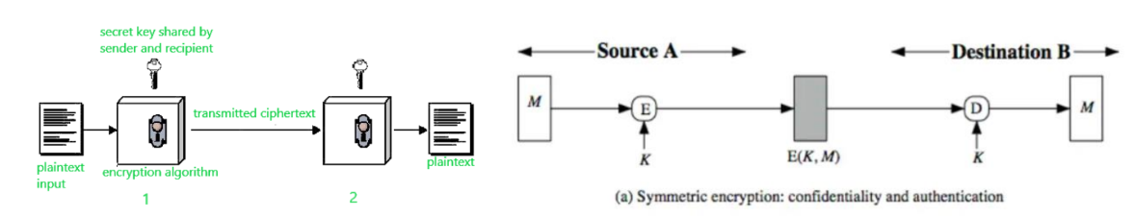
Symmetric Encryption for message Authentication
Assume only sender and receiver share a key
Single key for both encryption and decryption
Sender encrypts plaintext using the receiver’s secret key, which
can be later used by the receiver to decrypt the ciphertext.

Slide 12
Asymmetric Encryption for message Authentication
Public and private keys

Slide 13
Let’s analyze
Scheme 1:
A: Encrypt with K_{public-B}[M], send to B
B: Decrypt with K_{private-B} to obtain M
Authentication?: No
Confidentiality?:Yes

Slide 14
Scheme 2:
A: Encrypt with K_{private-A}[M], send to B
B: Decrypt with K_{public-A} to obtain M
Authentication? :Yes
Confidentiality?: No

Slide 15
Scheme 3:
A: Encrypt with K_{public-B} [Encrypt with K_{private-A}[M]], send to B
B: Decrypt first with K_{private-B} and then with K_{public-A} to obtain M
Authentication? :Yes
Confidentiality?: Yes

Slide 16
Hash functions
Concept
Hash function features
Hash function properties
MESSAGE INTEGRITY
Document and Fingerprint
Message and Message Digest
Cryptographic Hash Function Criteria
Birthday Problems

Slide 17
Hash Function
A hash function is a mathematical function that converts a numerical input value into another compressed numerical value.
The input to the hash function is of arbitrary length but output is always of fixed length.
Values returned by a hash function are called message digest or simply hash values

Slide 18
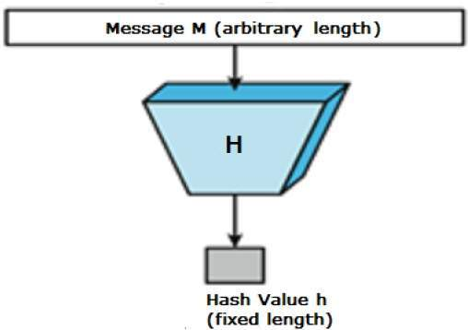
Hash Function
Image Source:https://www.tutorialspoint.com/cryptography/cryptography_hash_functions.htm

Slide 19
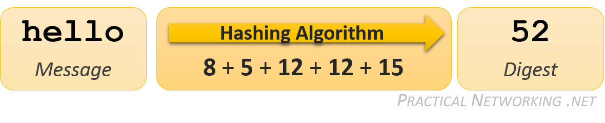
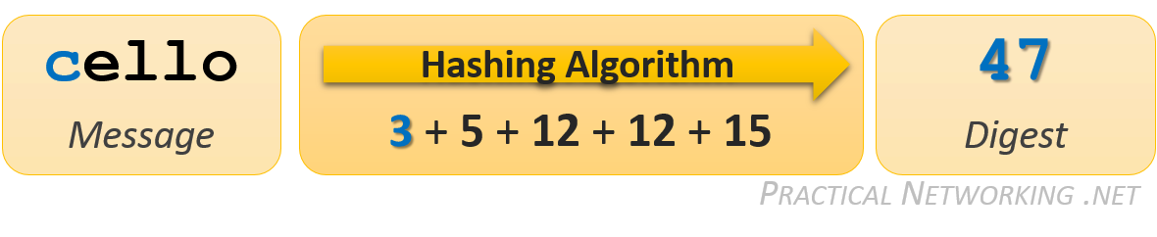
Hash function examples
By comparing the hash values of each calculation, it is easy to determine if the message is changed
Image source: https://www.practicalnetworking.net/series/cryptography/hashing-algorithm/

Slide 20
Flaws?
many words might result in the same hash value.
Hello and cellt, both messages result in hash value= 52, i.e. more than one words might have same hash output
In such scenario, message alteration would go undetected

Slide 21
Hash Algorithm
A one way function that converts data string into fixed length numeric string output
Output is generally smaller than input, hence called message digest or message compression algorithm

Slide 22
What is a hash function?
Compression: A function that maps arbitrarily long binary strings to fixed length binary strings
Ease of Computation: Given a hash function and an input it should be easy to calculate the output
Often used to create a hash table where the hash function computes the index into the table

Slide 23
Hash Function Properties
It is mathematically impossible to extract the original message from the digest.
Hashing is sometimes referred to as one-way encryption:
message can be encrypted but is impossible to decrypt.
This is accomplished using one-way functions within the hashing algorithm.
It is impossible to derive ‘hello’ knowing only a resulting hash value of ’52’. Mostly because there could be thousands of messages that result in the identical output.

Slide 24
Hash Function
A slight change to the original message causes a drastic change in the resulting digest.
Any minor modification – even as small as changing a single character – to the original Message should greatly alter the computed hash result
This is sometimes referred to as the Avalanche effect.
If for two different messages, hash to same output, then this term is known as Collision.

Slide 25
Hash Function
The result of the hashing algorithm is always the same length.
It is vital for the resulting hash value to not provide any hints or clues about the original Message – including its length.
A hash result should not grow in size as the length of the Message increases.

Slide 26
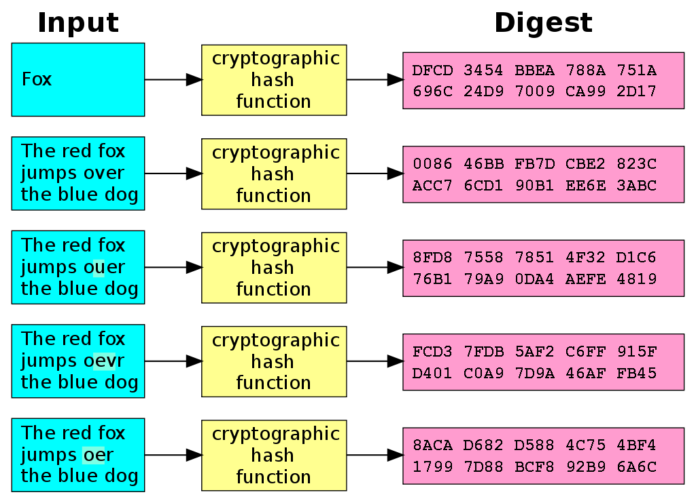
A slight change in input causes larger change in output
Image source: https://en.wikipedia.org/wiki/Cryptographic_hash_function#/media/File:Cryptographic_Hash_Function.svg

Slide 27
Hash Function
It is infeasible to construct a message which generates a given digest.
In this example, if hash value result = 52 is given, it would not be overly difficult to generate a list of words that might have been the original message.

Slide 28
Cryptographic Hash Function properties
It is computationally infeasible to find either
A data object that maps to a pre-specified hash result (the one-way property)
Two data objects that map to the same hash result (the collision-free property)

Slide 29
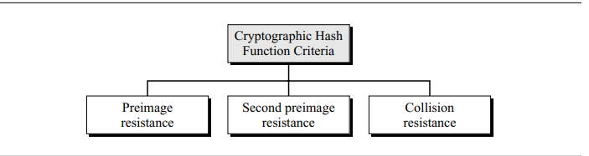
Cryptographic Hash Function Criteria
A cryptographic hash function must satisfy three criteria:
preimage resistance,
Second preimage resistance,
collision resistance,

Slide 30
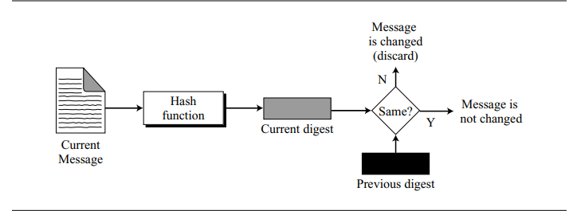
Checking message integrity

Slide 31
Properties of a Hash Function
Preimage Resistance (One Way): For essentially all pre-specified outputs, it is computationally infeasible to find input which hashes to given output.
Second Preimage Resistance (Weak Col. Res.): It is computationally infeasible to find any second input which has the same output as any specified input.
Collision Resistance (Strong Col. Res.): It is computationally infeasible to find any two distinct inputs which hash to the same output.

Slide 32
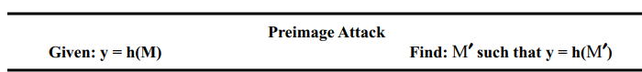
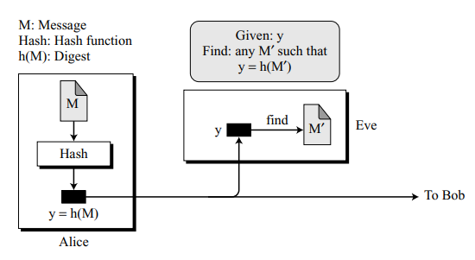
1. Preimage Resistance
A cryptographic hash function must be preimage resistant.
Given a hash function h and Y = h(M), it must be extremely difficult for Eve to find the message, M, such that h(M)=Y.
Given only a message value, one should not be able to find another input (preimage) that generates same hash result

Slide 33
Preimage Resistance
If the hash function is not preimage resistant, Eve can intercept the digest Y= h(M)
She Can find the message M
Loses confidentiality of message

Slide 34
Preimage Resistance
Computationally hard to reverse a hash function.
In other words, if a hash function h produced a hash value z, then it should be a difficult to find any other input value x that hashes to z.
This property protects against an attacker who only has a hash value and is trying to find the input.

Slide 35
2. Second Preimage Resistance
Second preimage resistance, ensures that a message cannot easily be forged.
If Alice creates a message and a digest and sends both to Bob, this criterion ensures that Eve cannot easily create another message that hashes to the exact same digest.
In other words, given a specific message and its digest, it is impossible (or at least very difficult) to create another message with the same digest.

Slide 36
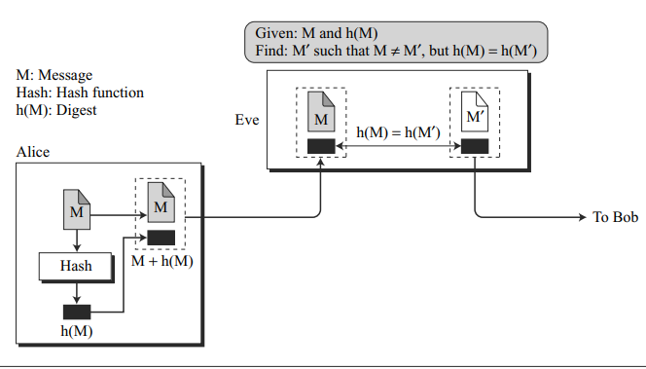
2. Second Preimage Resistance
Eve intercepts (has access to) a message M and its digest h(M).
She creates another message M′≠ M, but h(M) = h(M′).
Eve sends the M′ and h(M′) to Bob.
Eve has forged the message.

Slide 37
Second preimage resistance
The property says the following: if I give you an input and the digest it hashes to, you should be unable to find a different input that hashes to the same digest.
Given message m1, it is difficult to produce another message m2 such that , H(m1) = H(m2).

Slide 38
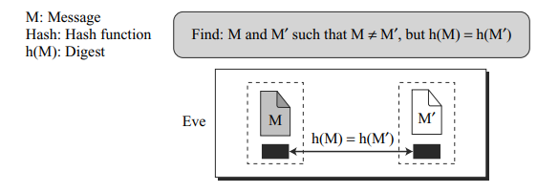
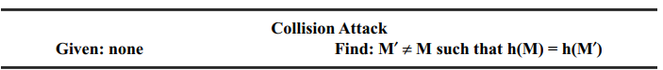
3. Collision resistance

Slide 39
First preimage attack — an attacker can find the original input from a hash.
Second preimage attack — an attacker is given one input and can find a matching input that results in the same hash

Slide 40
Summary
An attacker is provided information and must find other information that meets certain criteria
Preimage Resistance
Given: H(M)
Find: M
Second Preimage Resistance
Given: H(M) and M
Find: M´ such that H(M) = H(M´) and M ≠ M ´
Collision Resistance
Given: nothing
Find: random M and M´ such that H(M) = H(M´) and M ≠ M

Slide 41
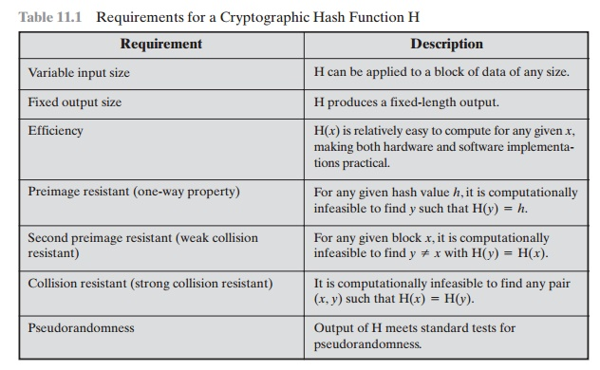
Image source: https://www.brainkart.com/article/Requirements-and-Security_8448/

Slide 42
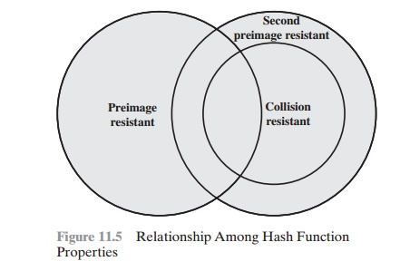
Relationship among hash function properties
Image source: https://www.brainkart.com/article/Requirements-and-Security_8448/

Slide 43
Hash Function Attacks
A hash function attack is an attempt to find two input strings of a hash function that produce the same hash result.
Because hash functions have infinite input length and a predefined output length, there is inevitably going to be the possibility of two different inputs that produce the same output hash.
A hash collision occurs when two separate inputs produce the same hash output.
Can be exploited by an application that compares two hashes together (such as password hashes, file integrity checks).
However, the odds of a collision are extremely low, but as available computational power increases, the ability to attack hash functions becomes more feasible.

Slide 44
How Does a Hash Function Attack Occur?
Collision attack:
A collision attack on a cryptographic hash tries to find two inputs producing the same hash value.
The attacker does not have control over the content of the message, but they are arbitrarily chosen by the algorithm.
In this case, H(A) is equal to H(B).
Pre-image attack: In contrast to a collision attack, in a pre-image attack the hash value is specified.
Birthday attack:
Is based on the birthday paradox, i.e., the probability that in a set of n randomly chosen people, some pair of them will have the same birthday.
Applied to hash function attacks, this means you have a 50% chance to break the collision resistance.

Slide 45
Birthday Attacks
Problem 1:
What is the minimum number, k, of students in a classroom such that it is likely that at least one student has a predefined birthday?
Problem 2:
What is the minimum number, k, of students in a classroom such that it is likely that at least one student has the same birthday as the student selected by the professor?
Problem 3:
What is the minimum number, k, of students in a classroom such that it is likely that at least two students have the same birthday?
Problem 4:
We have two classes, each with k students. What is the minimum value of k so that it is likely that at least one student from the first classroom has the same birthday as a student from the second classroom?

Slide 46
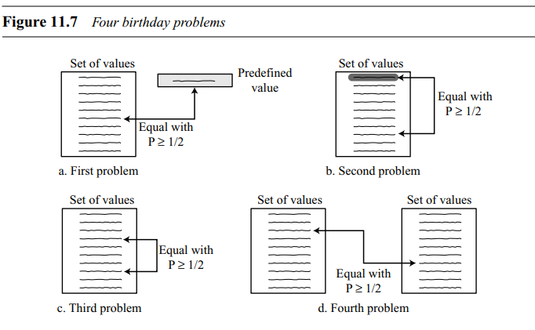
Birthday Problems

Slide 47
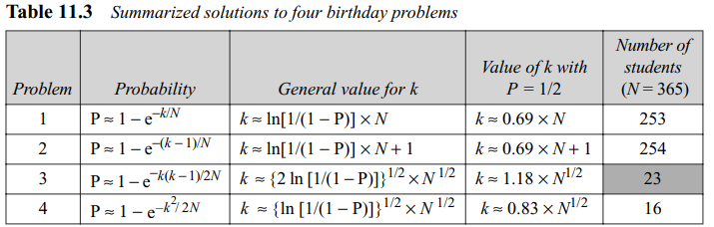
Birthday Problems
if there are just 23 students in a classroom, it is likely (with P ≥ 1/2) that two students have the same birthday (ignoring the year they have been born).

Slide 48
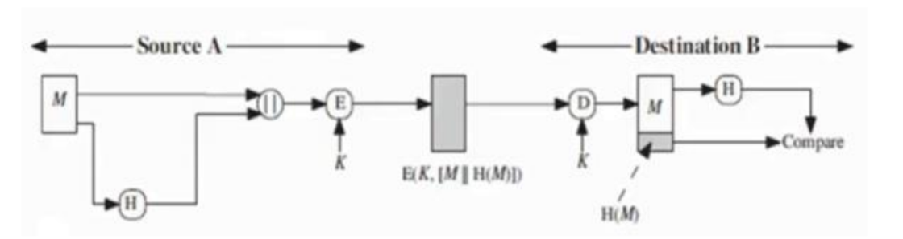
Hash with authentication and confidentiality
Method 1: Message and Hash code are encrypted
A : Hash[M]+E_{key}[M], send to B
B: D_{key}[M], Compute Hash[M], compare two hashes, accept if values are same
Authentication? : Yes
Confidentiality? Yes

Slide 49
Hash with authentication and NO confidentiality
Method 1: Only Hash code is encrypted
Symmetric Encryption
A : E_{key} [Hash[M]]+M, send to B
B: D_{key}[Hash[M]], Compute Hash[M] from received M, compare two hashes, accept if values are same
Authentication? : Yes
Confidentiality? No

Slide 50
Hash with authentication and NO confidentiality
Method 1: Only Hash code is encrypted
ASymmetric Encryption
A : E_{key-Private-A} [Hash[M]]+M, send to B
B: D_{key-Public-A}[Hash[M]], Compute Hash[M] from received M, compare two hashes, accept if values are same
Authentication? : Yes, strong sender’s authentication
Confidentiality? No

Slide 51
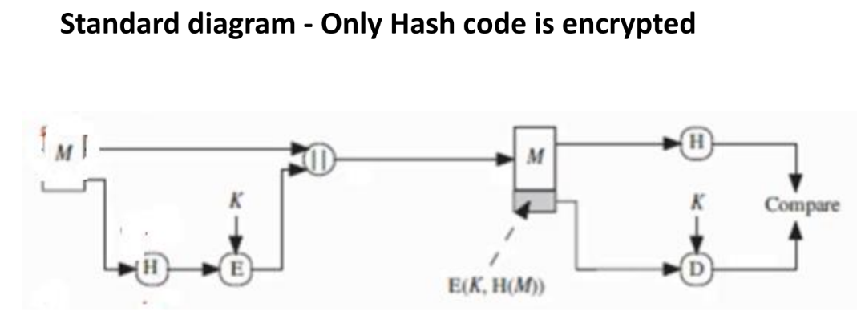

Slide 52
Hash with authentication and NO confidentiality
Method 3: Use secret code
Asymmetric Encryption
A : Hash[Secretcode[M]]+M, send to B
B: Compute Secretcode[M] + Compute Hash[Secretcode[M]], compare two hashes, accept if values are same
Authentication? : Yes
Confidentiality? No

Slide 53
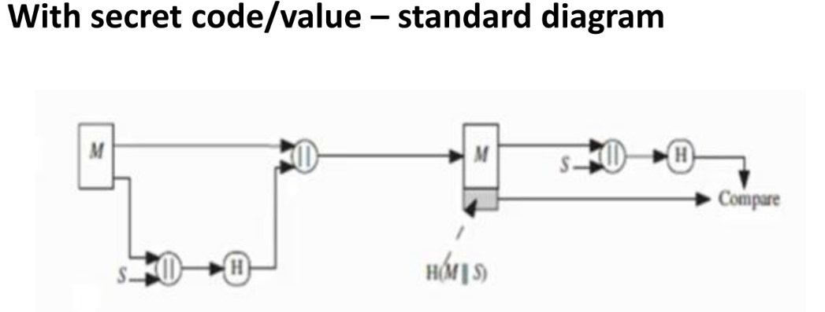
Hash with authentication and NO confidentiality

Slide 54
Hash with authentication and confidentiality
Method 4: Use secret code, message encrypted
A: E_{key} [Hash[Secretcode[M]]+M], send to B
B:
Decrypt received Cipher to get M +Hash[Secretcode[M],
compute Hash[Secretcode[M] from decrypted M,
Compare two hashes,
Accept if they match

Slide 55
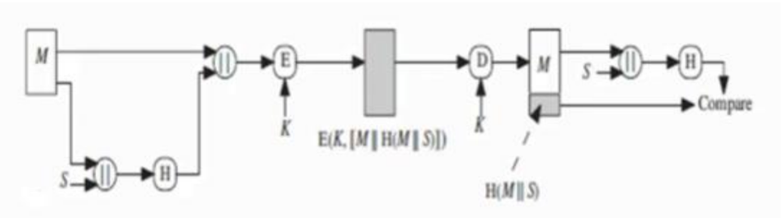
Hash with authentication and confidentiality

Slide 56
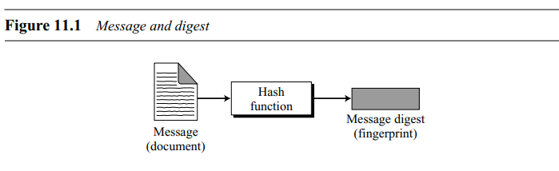
Message integrity
Sometimes, message integrity is more important than confidentiality
E.g. an assignment, a ‘will’
Solutions
Document Fingerprint (put the fingerprint at the end of document)
Message and Message Digest
The electronic equivalent of the document and fingerprint pair is the message and digest pair.

Slide 57
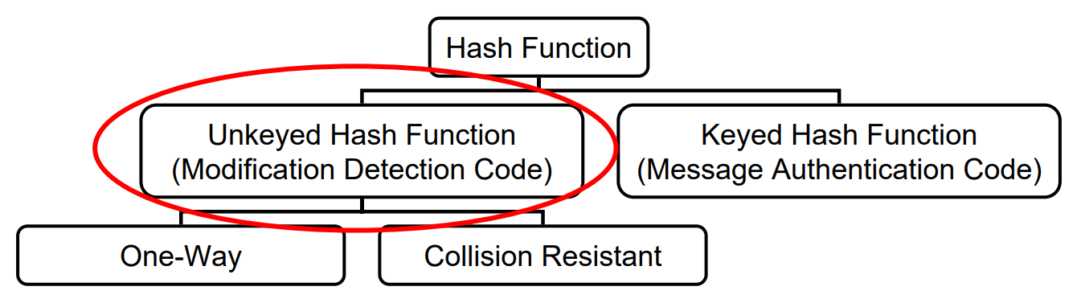
Types of Cryptographic Hash Functions

Slide 58
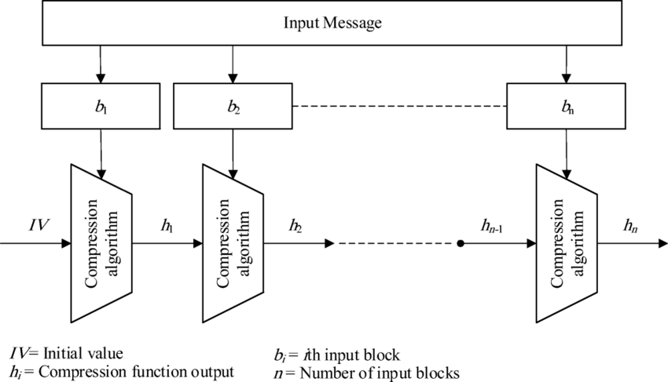
Hash Function Structure
Image source: https://www.researchgate.net/publication/330659532_A_new_efficient_and_configurable_image_encryption_structure_for_secure_transmission/figures?lo=1

Slide 59
Simple hash function
All hash functions operate on two principles
The input message is divided in a sequence of n-bit blocks
While processing the input, process only one block at a time

Slide 60
One way hash function
A one way hash function H(M) operates on an arbitrary length pre-image message M and returns a fixed length value h
h=H(M)
The ‘h’ is easy to compute, but significantly harder to reverse.
i.e. given M, its easy to compute H(M), but given H(M), its hard to compute M.
Its also hard to fine another message M’ such that H(M’)=H(M). (collision resistance)

Slide 61
Hash function families
Two widely used families the MD family and the SHA family
Rivest and RSA laboratories developed MD4 and now MD5.
The original MD was never published; MD2 was the first of the family to appear, and it was followed by MD4.
The NSA developed SHA-1 and SHA-2. Around February 2005, problems with SHA-1 became public.

Slide 62
Hash function families
Message digest family
Designed by Ron Rivest
MD2, MD4, MD5
Secure hash algorithm family
Designed by NIST
SHA-0, SHA-1 AND SHA-2
SHA-2: SHA-224, SHA-256, SHA-384, SHA-512
SHA-3 : new standard in competition, released in August 2015
Race Integrity Primitive Evaluation Message Digest (RIPEMD)

Slide 63
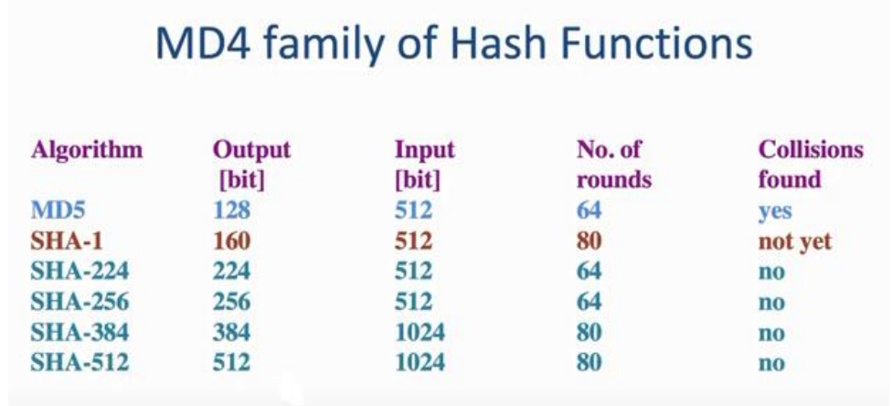
MD Family

Slide 64
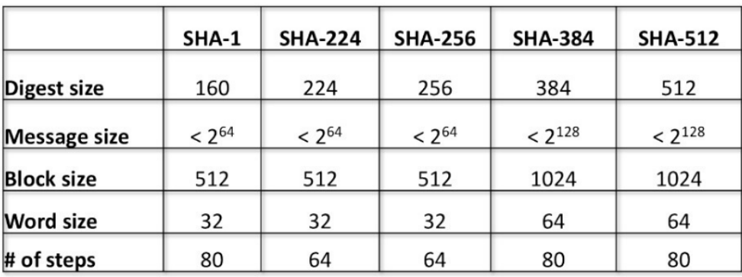
SHA versions

Slide 65
Why need of a new hash standard?
Md5 and SHA-0 are already broken
SHA-1 is not fully yet broken
But it is similar to MD5 and SHA-0, so can be broken
So considered insecure
SHA-2, especially SHA-512 seems secure
Shares same structure and mathematical operations as predecessors, so is matter of concern

Slide 66
Secure Hash Algorithm- SHA

Slide 67
Secure Hash Algorithm- SHA
Developed by the National Institute of Standards and Technology (NIST)
published as a federal information processing standard (FIPS 180) in 1993;
a revised version was issued as FIPS 180-1 in 1995 and is generally referred to as SHA-1.
SHA-1 produces a hash value of 160 bits.
The SHA-1 is called secure because it is computationally infeasible to find a message which corresponds to a given message digest, or to find two different messages which produce the same message digest

Slide 68
History-Secure Hash Algorithm- SHA
In 2002, NIST produced a revision of the standard, FIPS 180-2, that defined three new versions of SHA, with hash value lengths of 256, 384, and 512 bits, known as SHA-256, SHA-384, and SHA512.
Collectively, these hash algorithms are known as SHA-2. These new versions have the same underlying structure and use the same types of modular arithmetic and logical binary operations as SHA-1.
In 2005, NIST announced the intention to phase out approval of SHA-1 and move to a reliance on the other SHA versions by 2010.

Slide 69
Features of SHA-512
A hashing algorithm used to convert text of any length into a fixed-size string.
Each output produces a SHA-512 length of 512 bits (64 bytes).
This algorithm is commonly used for
email addresses hashing
password hashing
digital record verification.
With a message digest of 512 bits, SHA-512 expected to be resistant to all attacks, including collision attacks.

Slide 70
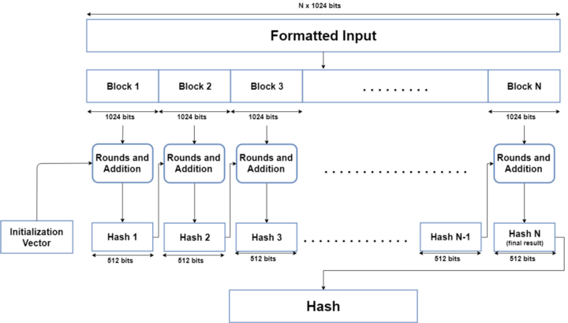
SHA 512 working

Slide 71
SHA-512 stages
Input formatting
Hash buffer initialization
Message Processing
Output

Slide 72
Input formatting
SHA-512 can’t actually hash a message input of any size, i.e. it has an input size limit.
Message has basically three parts:
the original message,
padding bits,
size of original message.
Combined size of the whole message must be multiple of 1024 bits.

Slide 73
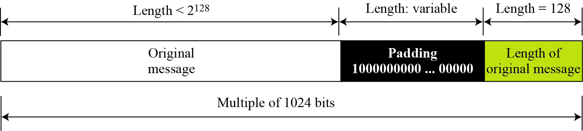
Input formatting:Padding
Padding bits to get message of the desired length.
Padding: ‘0’ bits with a leading ‘1’ (100000…000).
Padding size
Original message size : represented in 128 bits
The only reason that the SHA-512 has a limitation for its input message.

Slide 74
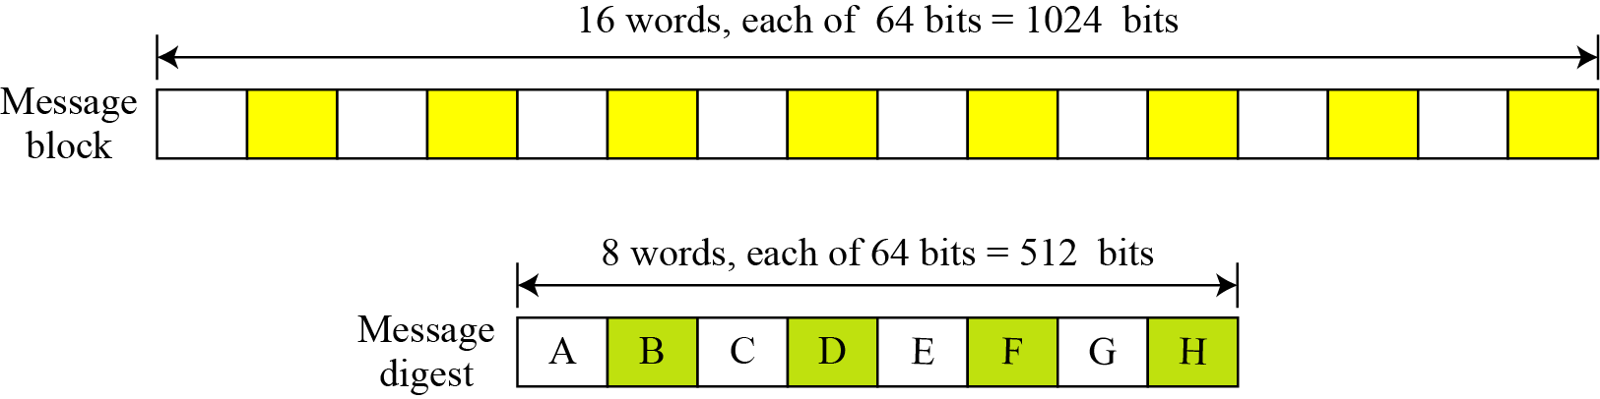
Input formatting
Words
Input message block and output digest as words

Slide 75
Step 2: Hash buffer initialization
Processes each block of 1024 bits from the message using the result from the previous block.
first block?
Uses a Initialization Vector
Store intermediate result for processing the next block in hash buffer
Also holds the final hash digest of the entire processing phase of SHA-512 as the last of these ‘intermediate’ results.

Slide 76
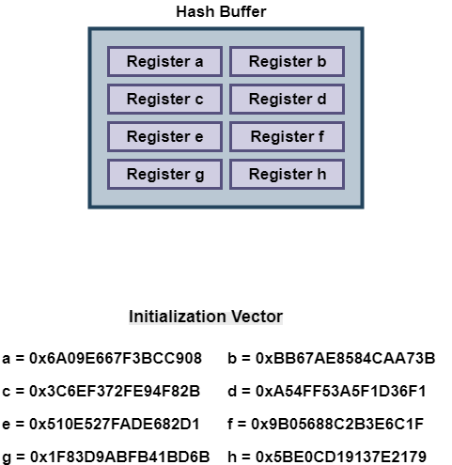
Initialization vector
IV is initialized with first 64 bits of the fractional parts of the square roots of the first 8 prime numbers (2,3,5,7,11,13,17,19).

Slide 77
Step 3: Message Processing
Message processing is done upon the formatted input by taking one block of 1024 bits at a time.
The actual processing uses:
The 1024 bit block, and
the result from the previous processing.
This part of the SHA-512 algorithm consists of several ‘Rounds’ and an addition operation.
So, the Message block (1024 bit) is expanded out into ‘Words’ using a ‘message sequencer’.
16 Words to be precise, each of them having a size of 64 bits.

Slide 78
Message processing Rounds
Each round takes 3 things:
one Word,
the output of the previous Round,
and a SHA-512 constant.
The first Round uses the Initial Vector (IV)
SHA-512 constants are predetermined values
First 64 bits from the fractional part of the cube roots of the first 80 prime numbers, one for each round
Every round gives an output of 512 bits.
Total rounds = 80 Rounds.
After the 80th Round, its output is simply added to the result of the previous message processing phase to get the final result for this iteration of message processing.

Slide 79
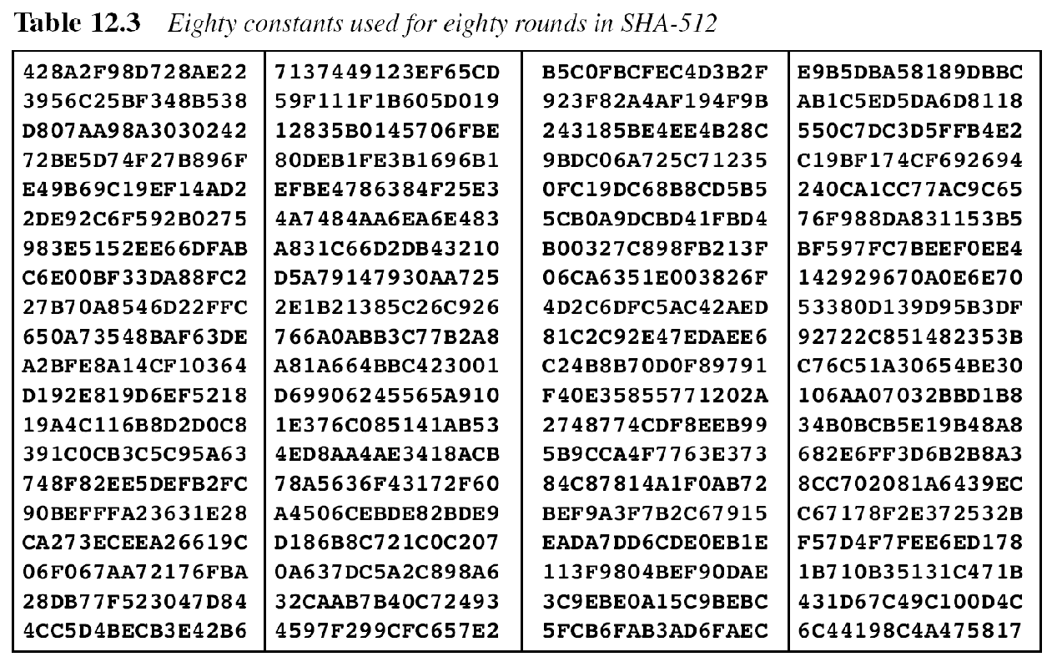
Reading slide

Slide 80
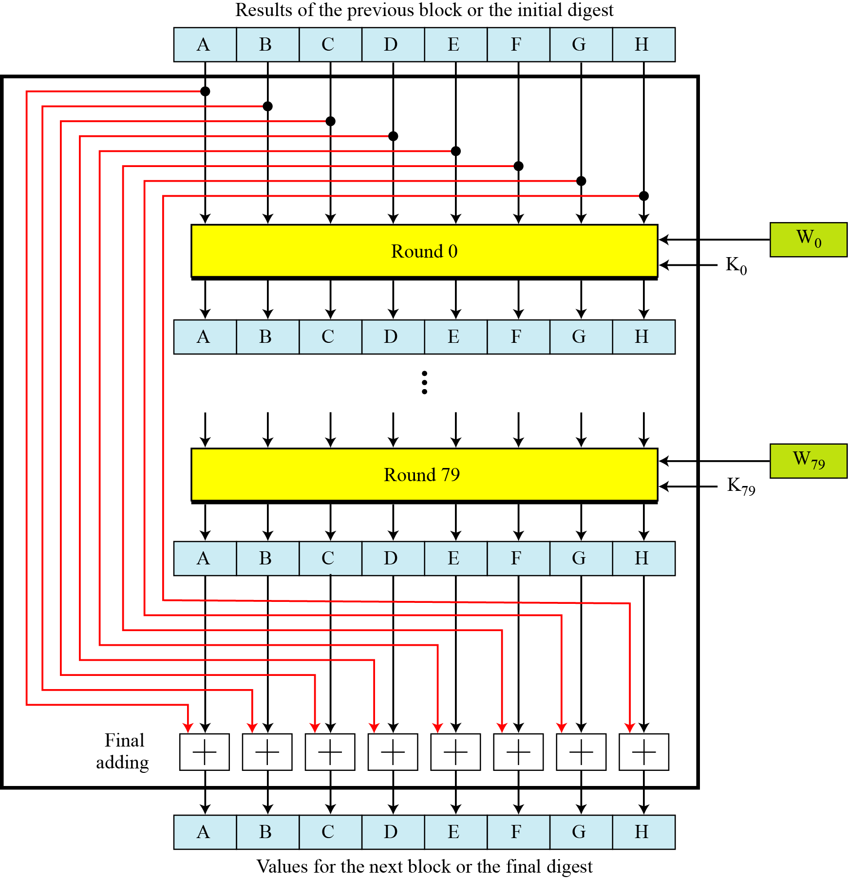
Compression function in SHA-512

Slide 81
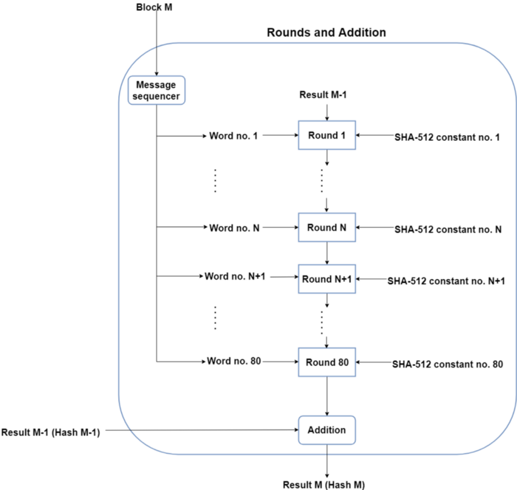
Simplified compression function

Slide 82
Step 4 : Output
After every block of 1024 bits goes through the message processing phase, the final 512 bit Hash value is generated
So, the intermediate results are all used from each block for processing the next block.

Slide 83
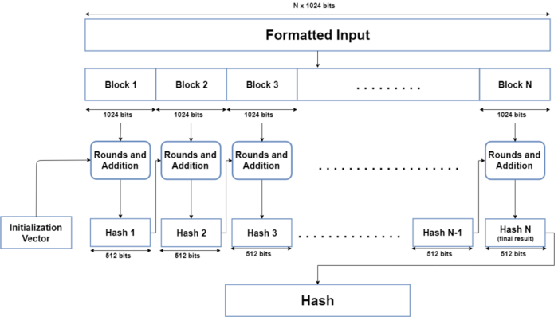

Slide 84
Blockchain Projects That Use The SHA 512
AlgorithmBitShares (BTS)
LBRY Credits (LBC)
Kcash (KCASH)

Slide 85
Non-Blockchain Applications For SHA-512
SHA-512 was used to authenticate archival video from the International Criminal Tribunal of the Rwandan genocide.
Unix and Linux vendors use both SHA-256 and SHA-512 for secure password hashing.
An email suppression list solution called OPTIZMO provides the storage and distribution of SHA-512 hashed email addresses for major clients such as Salesforce, LendingTree, Hotwire, and eharmony.

Slide 86
SHA 512
There are no known attacks against SHA-512, not against collision resistance and certainly not against first or second preimage resistance
Doesn't have any known vulnerabilities that make it insecure and it has not been “broken” unlike some other popular hashing algorithms.
SHA-512 is faster than SHA-256.
Technically speaking SHA512 password hashes are not cracked or decrypted .

Slide 87
HMAC- Hash based message authentication code
uses a hash function in combination with a secret key.
Used to verify the integrity and authenticity of a message.
•HMACs are almost similar to digital signatures.
They both enforce integrity and authenticity.
They both use cryptography keys
And they both employ hash functions.
•The main difference is that digital signatures use asymmetric keys, while HMACs use symmetric keys (no public key)

Slide 88
HMAC working
A message M: N blocks of length b bits.
Padding: An input signature is padded to the left of the message
Padded message is passed as input to a hash function which gives a temporary message digest: MD’
MD’ again is appended to an output signature
MD’+ o/p signature is processed with a hash function again to get final message digest MD.

Slide 89
HMAC working
The message is divided into N blocks, each of b bits.
The secret key is left-padded with 0’s to create a b-bit key. Recommendation: secret key (before padding) should be longer than n bits, where n is the size of the HMAC.
The result of step 2 is exclusive-ored with a constant called ipad (input pad) to create a b-bit block. The value of ipad is the b/8 repetition of the sequence 00110110 (36 in hexadecimal).
The resulting block is prepended to the N-block message. The result is N + 1 blocks.
The result of step 4 is hashed to create an n-bit digest. We call the digest the intermediate HMAC

Slide 90
HMAC working
The intermediate n-bit HMAC is left padded with 0s to make a b-bit block.
Steps 2 and 3 are repeated by a different constant opad (output pad). The value of opad is the b/8 repetition of the sequence 01011100 (5C in hexadecimal).
The result of step 7 is prepended to the block of step 6.
The result of step 8 is hashed with the same hashing algorithm to create the final n-bit HMAC.

Slide 91
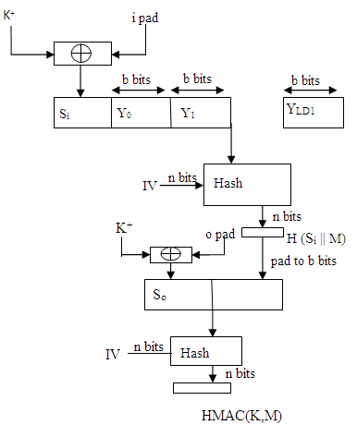
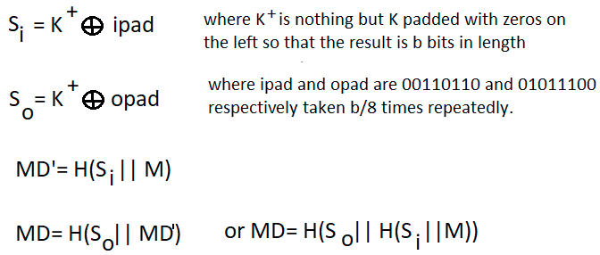
HMAC structure
H : Hashing function, M : original message Si and So : input and output Yi : the ith block in original message M, where i ranges from [1, L) L : number of blocks in M K : secret key used for hashing IV : initial vector (some constant)

Slide 92
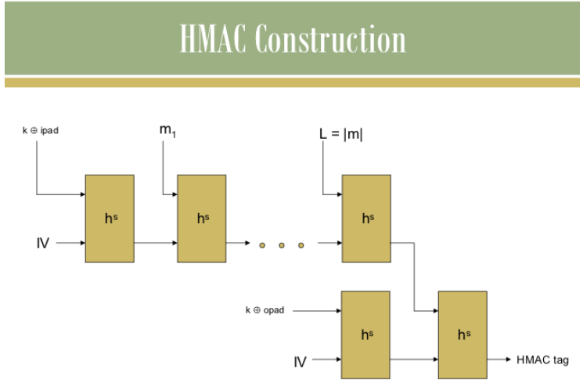

Slide 93
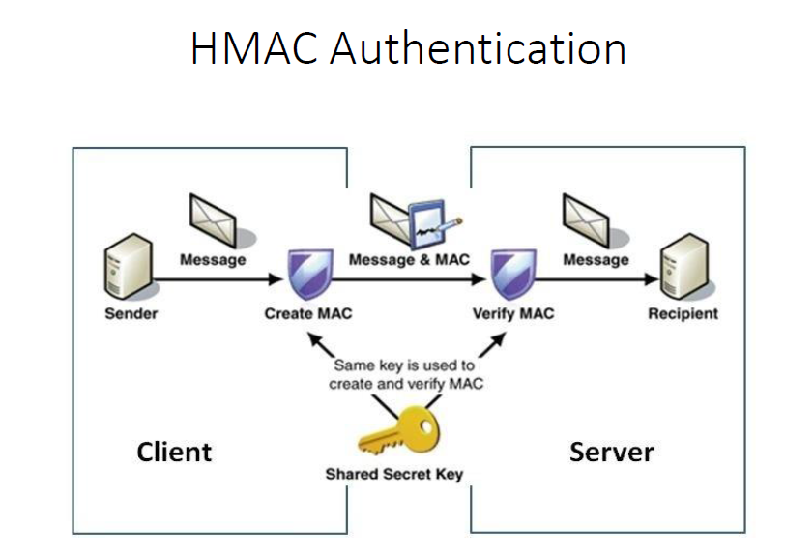

Slide 94
HMAC Security
Security depends on the cryptographic strength of the underlying hash function
It is much harder to launch successful collision attacks on HMAC because of secret key

Slide 95
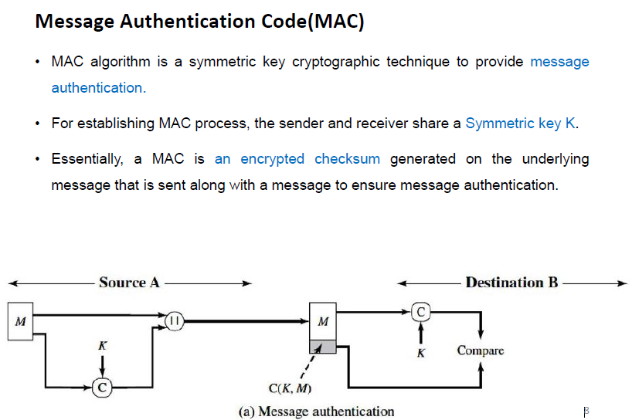
MAC

Slide 96
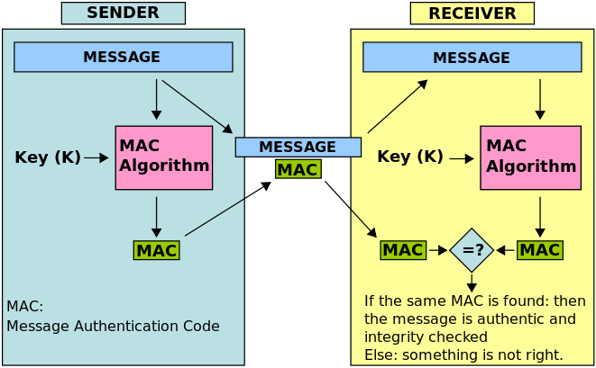

Slide 97
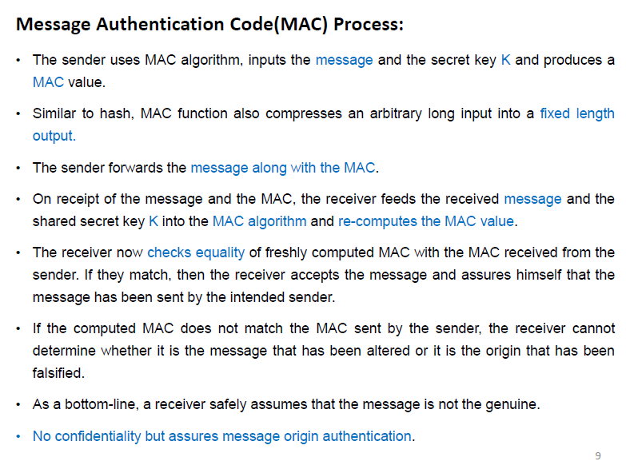

Slide 98
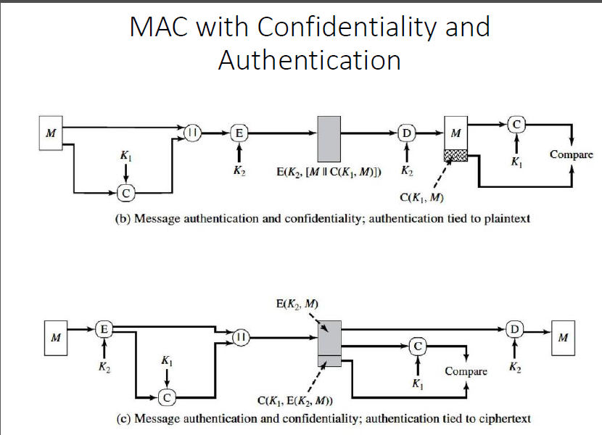

Slide 99
Message Authentication Code
To realize and construct MAC algorithms, two different cryptographic primitives are used.
MACs can be implemented using cryptographic hash functions or using symmetric block ciphers.
Cryptographic hash functions-HMAC
Symmetric block ciphers–
Data Authentication Algorithm,
Cipher based Message Authentication Code (CMAC)
CBC–MAC(it used AES)and
variant of CBC –MAC is CMAC (AES+tripleDES)

Slide 100
MAC Based on block ciphers
Data Authentication Algorithm (DAA)
Cipher based Message Authentication Code (CMAC)

Slide 101
DAA
The Data Authentication Algorithm (DAA) is a former U.S. government standard for producing cryptographic MACs.
DAA was withdrawn in September 2008.
The algorithm is not considered secure by today's standards.
According to the standard, a code produced by the DAA is called a Data Authentication Code (DAC).
The algorithm chain encrypts the data, with the last cipher block truncated and used as the DAC.

Slide 102
Data Authentication Algorithm (DAA) widely used MAC based on DES-CBC (Cipher block chaining)
The message to be authenticated is grouped into contiguous 64-bit blocks: D1,D2,…,DN.
The final block is padded on the right with zeros to form a full 64-bit block
Using DES encryption algorithm E and a secret key K, Data Authentication Code (DAC) is calculated.

Slide 103
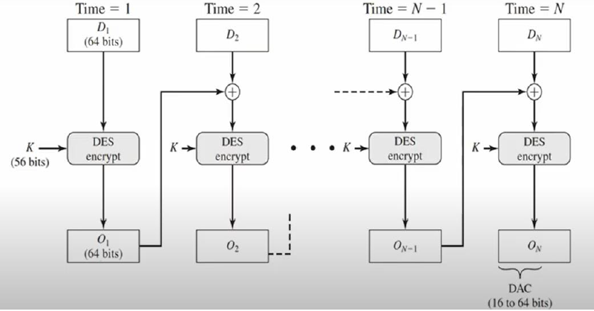
Digital Authentication Algo (DAA) working

Slide 104
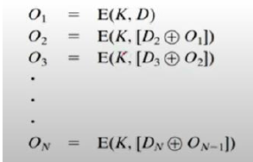
DAA

Slide 105
Reading Assignment
MAC Vs DAA

Slide 106
MD5
Reading Assignment

Slide 107
MD5
A cryptographic hash function
commonly used to verify
DATA integrity and
Generate checksums.
Steps:
Input Padding
Dividing input into blocks
IV initialization
Block processing
Update hash
Final hash

Slide 108
MD 5 working
Message Input: a text string, a file, or any other set of binary data.
Padding:
MD5 works on 512-bit (64-byte) blocks of data.
Padding ensures that the data can be divided into fixed-size blocks.
Dividing the Message: The padded message is divided into 512-bit blocks.
Initialize Constants:
MD5 uses a set of constants to mix and transform data during the hashing process.
These constants are predefined within the MD5 algorithm.
Initialization Vector (IV): predefined hexadecimal numbers.

Slide 109
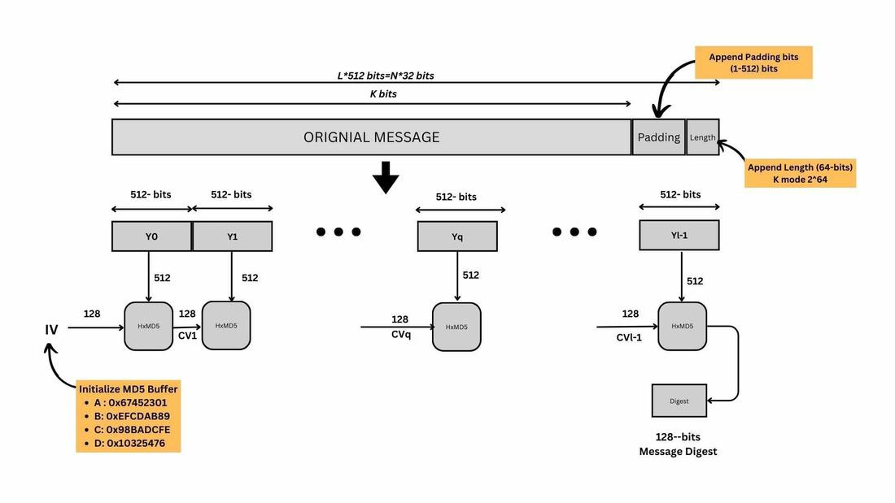
MD5 Working

Slide 110
MD 5 working
6. Processing Blocks:
Each block is processed one at a time.
Block is divided into 32-bit words.
Each block undergoes multiple rounds (usually 64 rounds).
Each round contains:
bitwise and logical Operations: AND, OR, XOR, etc, modular addition, and specific logical functions.
Each round combines the previous round's result with the current block's data.

Slide 111
MD 5 working
7. Updating the Hash:
As each block is processed, the hash value is updated.
MD5 has four 32-bit variables (A, B, C, and D) that represent the current hash value.
These variables are updated in each round of processing.
8. Final Hash:
Final hash value is a 128-bit (16-byte) hexadecimal number.
This value is often represented as a 32-character string of hexadecimal digits.

Slide 112
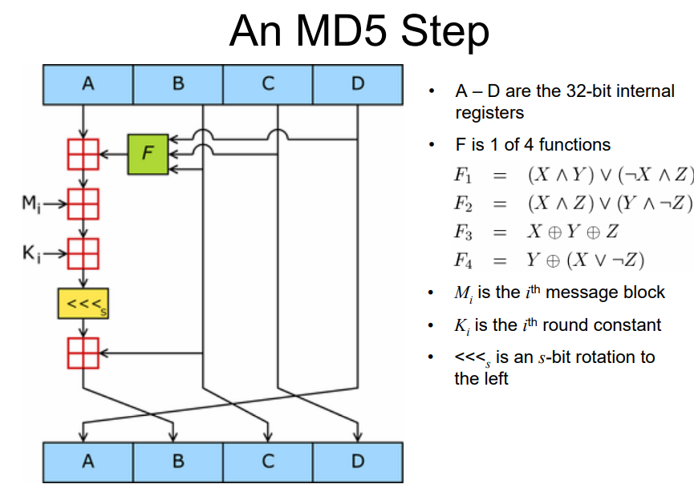

Slide 113
The MD5 Compression Function
Each iteration consists of 4 rounds of 16 steps each, each step processing 32-bits of the message
Each round processes all 512 of the input bits
4 round functions, 1 per round: F(X, Y, Z)
X,Y, Z are predefined
4 internal 32-bit registers store the current state of the algorithm
The internal registers are initialized to fixed constants

Slide 114
MD 5 security
MD5 has known vulnerabilities
is susceptible to collision attacks, where two different inputs can produce the same hash.
weaknesses make MD5 unsuitable for security-critical applications.

Slide 115
MD 5 strengths
Non-Cryptographic Use Cases:
MD5 can still be suitable for non-security-sensitive applications where cryptographic strength is not a primary concern.
E.g. checksums and data integrity verification where there is no malicious intent to manipulate the data.
Speed:
MD5 is relatively fast
advantageous in situations where performance is a significant consideration.
It can still be used for quick data deduplication or indexing.
Legacy Systems:
Some older systems may still use MD5 for compatibility reasons.
While this is not ideal from a security perspective, it may be necessary to work with these systems.

Slide 116
Applications for Hash Functions
Data Integrity
Downloading of large files often include the MD5 digest to verify the integrity of the file
Proof of Ownership
Publish the digest of a document describing a patent idea in the New York Times (“All the news that is fit to print”)
Digital Signatures
Digitally sign the digest of a message instead of the message to save computational time

Slide 117
Reading: How Secure are Hash Functions?
No hash function is collision free, but it usually takes extremely long to find a collision.
Even if a hash function has never been broken, a successful attack against a weakened variant may undermine the experts’ confidence and lead to its abandonment.
In the past, weaknesses had been found in several then-popular hash functions, including SHA-0, RIPEMD, and MD5.
These weaknesses called into question the security of stronger algorithms derived from the weak hash functions such as the SHA-1, RIPEMD-128, and RIPEMD-160.
Also, there are applications of cryptographic hash functions that do not rely on collision resistance.
This means that collision attacks do not affect their security.
For example, HMACs are not vulnerable.
For the hash attack to be successful, the attacker must be in control of the input to the hash function.

Slide 118
Current State of Hash Functions
Researchers try to break hash functions in 1 of 2 ways
Finding two messages (usually single message blocks) hash to the same digest
Find the message that creates the digest of all zeros or all ones (essentially finding a preimage)
Collisions and preimages can be found for MD4
Collisions can be constructed for MD5 and SHA-0
Theoretic collisions discovered for SHA-1
SHA-256 & SHA-512 have no known attacks

Slide 119
References
Forouzon
https://www.cs.purdue.edu/homes/ssw/cs355/hash.pdf

Slide 120
Public Key Infrastructures

Slide 121
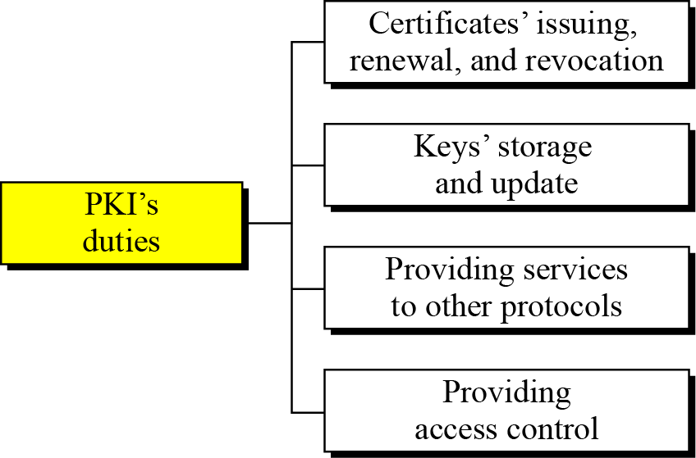
PKI duties

Slide 122
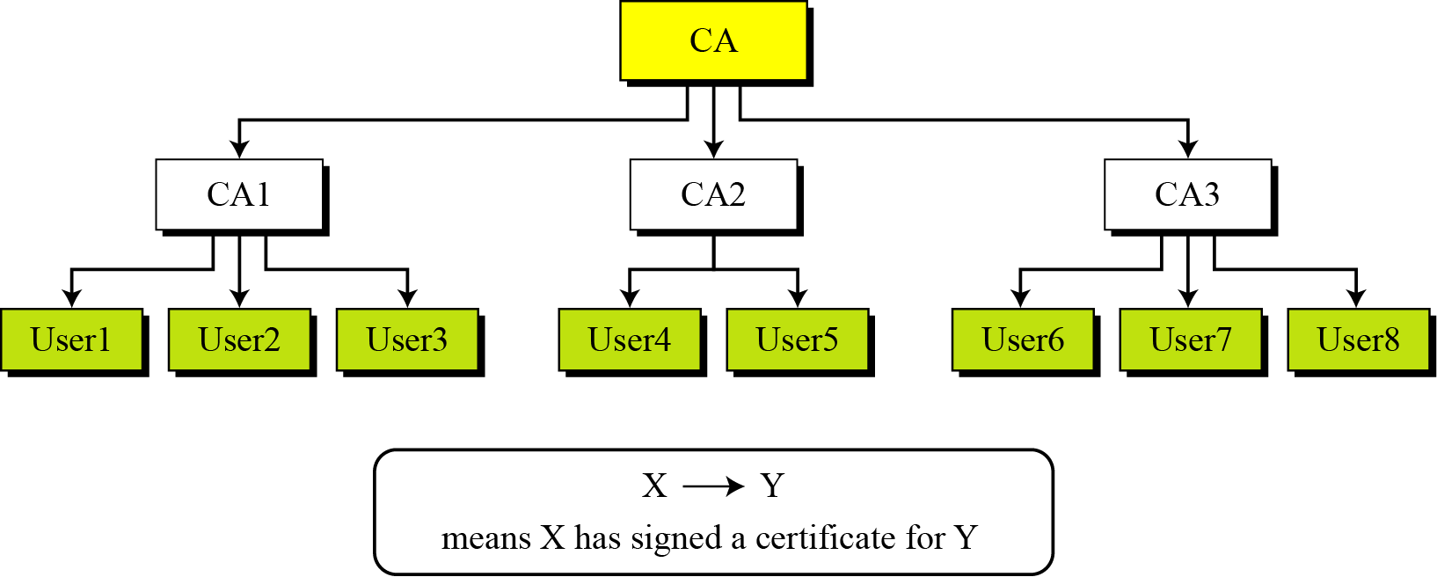
PKI hierarchical trust model

Slide 123
Show how User1, knowing only the public key of the CA (the root), can obtain a verified copy of User3’s public key.
Solution
User3 sends a chain of certificates, CA<<CA1>> and CA1<<User3>>, to User1.
a. User1 validates CA<<CA1>> using the public key of CA.
b. User1 extracts the public key of CA1 from CA<<CA1>>.
c. User1 validates CA1<<User3>> using the public key of CA1.
d. User1 extracts the public key of User 3 from CA1<<User3>>.

Slide 124
Example.. contd
Some Web browsers, such as Netscape and Internet Explorer, include a set of certificates from independent roots without a single, high-level, authority to certify each root. One can find the
list of these roots in the Internet Explorer at Tools/Internet Options/Contents/Certificate/Trusted roots (using pull-down menu). The user then can choose any of this root and view the certificate.

Slide 125
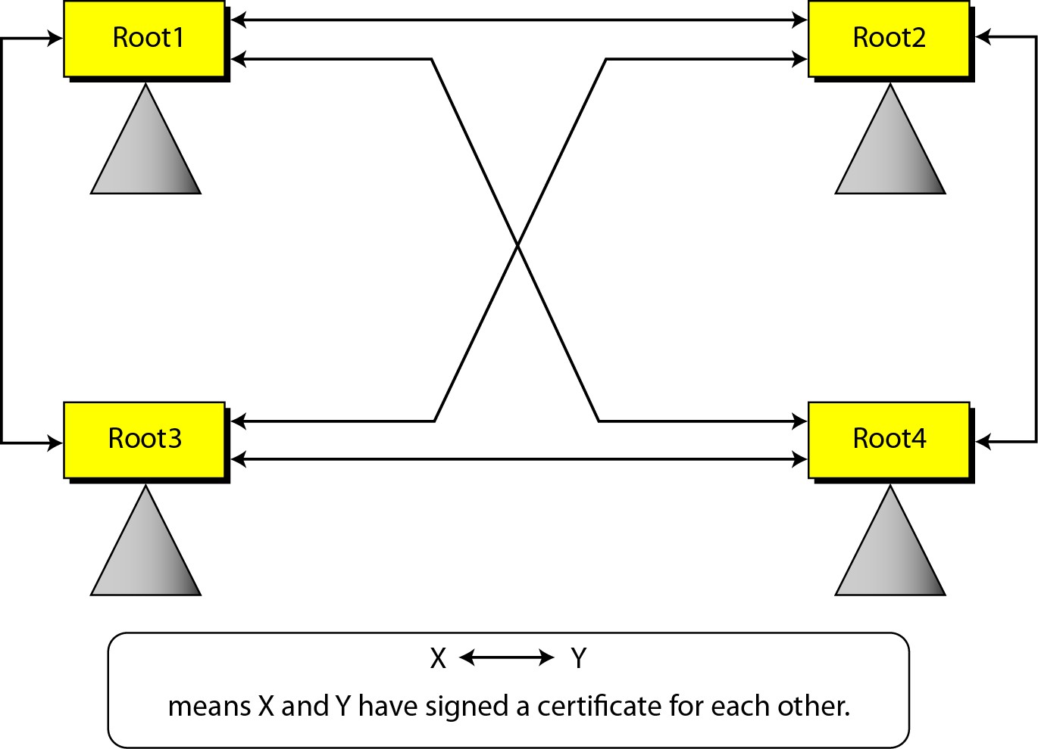
PKI Mesh Model

Slide 126
Example 2
Alice is under the authority Root1; Bob is under the authority Root4. Show how Alice can obtain Bob’s verified public key.
Solution
Bob sends a chain of certificates from Root4 to Bob. Alice looks at the directory of Root1 to find Root1<<Root1>> and Root1<< Root4>> certificates, Alice can verify Bob’s public key.

Slide 127
x.509 authentication service

Slide 128
X.509
Definition: X.509 is a standard defining the format of public key certificates.
X. 509 certificates are used in many Internet protocols, including TLS/SSL, which is the basis for HTTPS, the secure protocol for browsing the web.
Importance: Essential for secure communication and authentication in various applications.
History: Developed in the 1980s as part of the ITU-T X series.

Slide 129
Digital Certificates
Digital certificate is issued by a trusted third party which proves sender’s identity to the receiver and receiver’s identity to the sender.
A digital certificate is a certificate issued by a Certificate Authority (CA) to verify the identity of the certificate holder.
The CA issues an encrypted digital certificate containing the applicant’s public key and a variety of other identification information.
Digital certificate is used to attach public key with a particular individual or an entity.

Slide 130
X.509 Certificates
Definition: Digital documents used to verify the authenticity of an entity.
Components: Public key, identity information, digital signature.
Types: End-entity certificates and CA certificates.

Slide 131
Key Components of X.509
X.509 Infrastructure
A fundamental framework for establishing trust in digital communication.
Key Role: Ensures the authenticity, integrity, and confidentiality of data.
Public Key Infrastructure (PKI)
Definition: A subset of X.509, a PKI is a set of hardware, software, policies, and standards that work together to provide a framework for secure communications.
Components: Certificates, CAs, registration authorities, and directories.
Digital Certificates
Role: Digital documents that bind a public key to an entity's identity.Structure: Includes public key, subject, issuer, validity period, and digital signature
.Examples: SSL/TLS certificates, email certificates. Certification Authorities
Certification Authorities (CAs)
Role: Trusted entities that issue and verify certificates.
Types: Root CAs, Intermediate CAs, and End-entity CAs.
Hierarchy: Root CA signs the certificates of Intermediate CAs, forming a chain of trust.
Certificate Revocation Lists
Definition: Lists of revoked digital certificates issued by a Certificate Authority (CA).
Purpose: Ensure the security of digital communication by identifying compromised or no longer valid certificates.

Slide 132
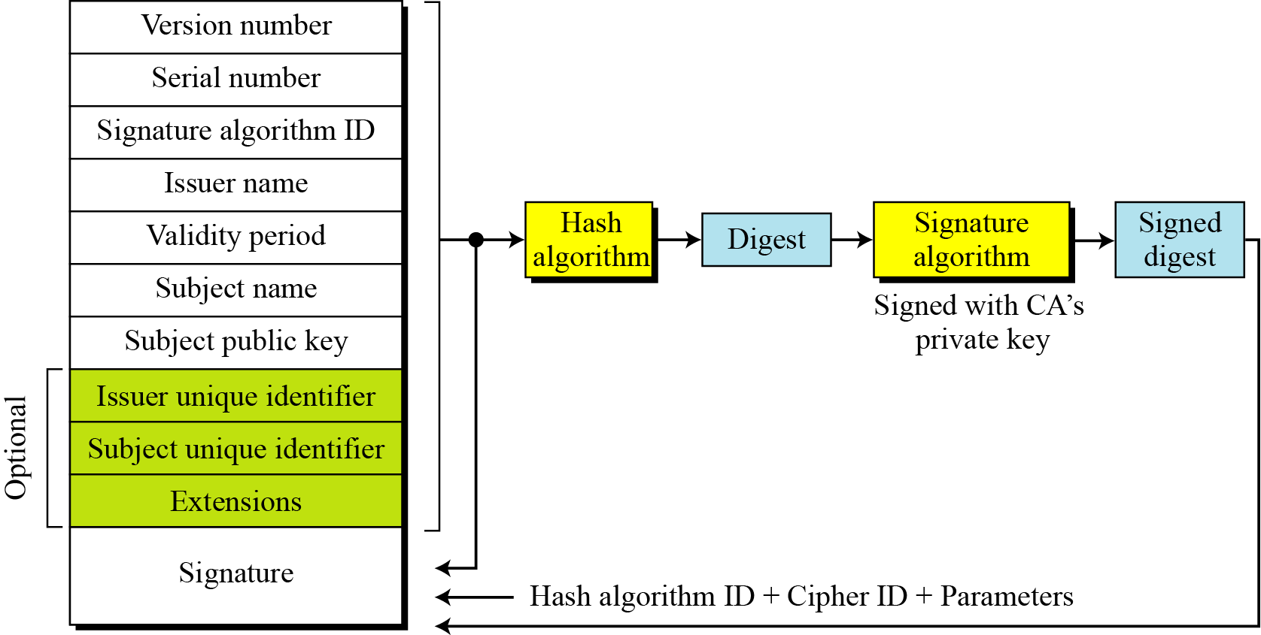
X.509 certificate format

Slide 133
Certificate Renewal
Each certificate has a period of validity. If there is no problem with the certificate, the CA issues a new certificate before the old one expires.
Certificate Renewal
In some cases a certificate must be revoked before its expiration.
Delta Revocation
To make revocation more efficient, the delta certificate revocation list (delta CRL) has been introduced.

Slide 134
Certificate revocation list format

Slide 135
Reasons of certificate revocation
User’s key is compromised
CA doesn’t wish to certify user for some reason( User’s certificate relates to the organization that she no longer works for.)
CA’s private key is compromised

Slide 136
How CRLs Work?
Issuance: CRLs are periodically issued by the CA.
Content: They contain the serial numbers of revoked certificates, a time of issue, and a next update time.
Distribution: CRLs are made publicly available and distributed to relying parties.

Slide 137
Why CRLs Are Important?
Assurance of Certificate Validity: CRLs help users and systems avoid relying on compromised or invalid certificates.
Trustworthiness: The presence of a CRL adds an additional layer of trust to the X.509 certificate infrastructure.
Regulatory Compliance: Many industries and standards require the use of CRLs for compliance.

Slide 138
Trust in the X.509 Infrastructure
Trust Model: Trust is established through the trusted root CA certificate.
Certificate Chain: Building and verifying certificate chains.
Revocation: Handling revoked certificates through CRLs and OCSP.

Slide 139
Applications of X.509 Infrastructure
SSL/TLS: Securing web traffic.
S/MIME: Secure email communication.
Code Signing: Authenticating software and updates.
VPNs: Establishing secure connections.

Slide 140
Challenges and Considerations in X.509
Security: Protecting private keys and mitigating vulnerabilities.
Trust: Ensuring CAs are reliable and secure.
Scalability: Handling a growing number of certificates.
Regulatory Compliance: Meeting legal and industry-specific requirements.

Slide 141
Future of X.509 Infrastructure
Quantum Computing: Impact on cryptographic algorithms.
Post-Quantum Cryptography: Preparing for quantum-resistant certificates.
Advances in PKI: Improving certificate management and trust models.

Slide 142
Digital Signature

Slide 143
Digital Signature
Traditional signature
Sign
Verify
Methods of forgery
Chances of forgery
Digital signature
Sign
Verify
Methods of forgery
Chances of forgery

Slide 144
Digital signatures
A cryptographic technique used to verify the authenticity and integrity of a digital message or document.
Provide a way for a sender to prove that a document has not been altered in transit and that it was indeed signed by the purported sender

Slide 145
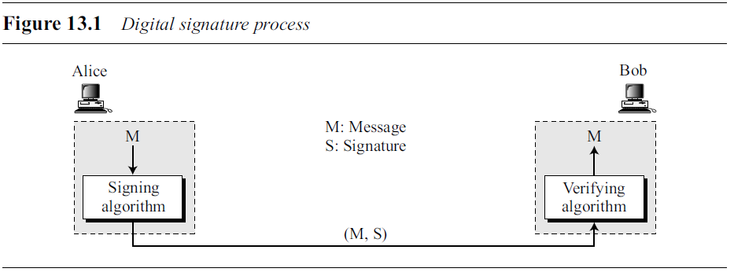
Digital signature process
The sender uses a signing algorithm to sign the message.
The message and the signature are sent to the receiver.
Receiver receives the message and signature
Receiver applies the verifying algorithm to the combination.
If the result is true, the message is accepted; otherwise, it is rejected.

Slide 146

Sign and verify
Which key should be used for signing- public or private?

Slide 147
Keys and digital signatures
The signer uses her private key, applied to a signing algorithm, to sign the document.
The verifier, on the other hand, uses the public key of the signer, applied to the verifying algorithm, to verify the document.
When a document is signed, anyone can verify it because everyone has access to sender’s public key.
Sender must not use her public key to sign the document because then anyone could forge her signature.

Slide 148
What if we use symmetric key cryptography?
The secret key is known by only two entities. So while sending document to third person, sender must use a diff key.
No of keys to be maintained is an issue
creating a secret key for a session involves authentication, which uses a digital signature, forming a vicious circle
No strong repudiation as key is known to more than one person
A digital signature needs a public-key system. The signer signs with her private key; the verifier verifies with the signer’s public key.

Slide 149

Signing digest

Slide 150

Trusted centre for nonrepudiation

Slide 151

Confidentiality and Digital Signatures

Slide 152
Key benefits
Authentication:
confirm the identity of the sender.
They are typically generated using the sender's private key, and can only be verified using the corresponding public key. This ensures that the sender is who they claim to be.
Data Integrity:
Even a minor alteration to the signed document will result in an invalid signature.
Non-Repudiation:
Once a digital signature is applied, the sender cannot deny their involvement in sending the document.
Especially important in legal and business contexts.

Slide 153

Image courtesy: https://slideplayer.com/slide/17591771/

Slide 154


Slide 155
Cryptographic services and digital certificates
Confidentiality,
Message authentication,
Message integrity
Nonrepudiation.

Slide 156
What Digital signatures cant achieve?
A digital signature does not provide privacy completely
Especially when message goes plain and hash values are signed
If there is a need for privacy, another layer of encryption/decryption must be applied.

Slide 157
Applications
Certificates and certification authorities have been developed
Following Protocols use services of CA
IPSec
SSL/TLS
S/MIME
PGP

Slide 158
Digital Signature vs Digital Certificate
Digital signatures and digital certificates are related but serve different purposes in the context of digital security and authentication.

Slide 159
 | Digital signature | Digital certificate
Purpose | A cryptographic technique that provides a way to verify the authenticity and integrity of a digital message or document. | A data file that associates a user's identity with their public key, enabling others to verify their identity. It is issued by a trusted Certificate Authority (CA) and serves as a digital ID card
Components | composed of two parts: the document or message itself and the attached digital signature. | contains information about the certificate holder, their public key, and the digital signature of the CA. It also includes the validity period of the certificate.
Process | created by the sender using their private key to encrypt a hash of the message or document. The recipient can verify the signature using the sender's public key. | Involves registration authority, certification authority, purpose of usage, validity of period, keys, hash algorithms used etc. Complicated process compared to Digital signatures

Slide 160
 | Digital signature | Digital certificate
Usage | used to authenticate the sender, provide data integrity, and ensure non-repudiation of digital messages and documents. | primarily used for public key infrastructure (PKI) applications, such as secure websites (HTTPS), email encryption and authentication, and digital signatures. They are a crucial part of authenticating users and securing online communications.
Issuer | Created by the sender of a specific message or document. | Issued by a trusted Certificate Authority (CA)
Application | Applied to individual messages or documents. | Used to secure communication channels, websites, and validate digital signatures.
Example | person signs an email with a digital signature to prove that the message is indeed from them and has not been altered in transit. | when one visits a secure website (e.g., an online banking website), the web browser checks the website's digital certificate to ensure that it is legitimate and not a malicious imposter.

Slide 161
Digital Signature Standard (DSS)

Slide 162
Digital Signature Standard (DSS)
DSS was adopted by the National Institute of Standards and Technology (NIST) in 1994.
NIST published DSS as FIPS 186.
DSS has been criticized from the time it was published.
The main complaint is regarding the secrecy of DSS design.
The second complaint is regarding the size of the prime, 512 bits.
Later NIST made the size variable to respond to this complaint.

Slide 163

DSS scheme general idea

Slide 164

Sign and Verify in DSS

Slide 165
DSS process
In the signing process, two functions create two signatures
in the verifying process, the output of one function is compared to the first signature for verification.
Another difference is that this scheme uses the message digest (not the message) as part of inputs to functions 1 and 3.
The interesting point is that the scheme uses two public moduli: p and q.
Functions 1 and 3 use both p and q; function 2 uses only q.

Slide 166
Reading:Key Generation in DSS
Alice chooses a prime p, between 512 and 1024 bits in length.
🡪No of bits in p must be a multiple of 64.
q is 160-bit prime in such a way that q divides (p − 1).
Alice uses two multiplication groups <Z_{p}*, × > and <Z_{q}*, ×>; the second is a subgroup of the first.
Alice creates e₁ to be the q^{th} root of 1 modulo p. i.e.
e₁^{q} = 1 mod p.
To do so, Alice chooses e₀ which is a primitive element in
Z_{p}, and calculates e₁ = e₀^{(p−1)/q} mod p.
Alice chooses d as the private key and calculates
e₂ = e₁^{d} mod p.
Alice’s public key is (e₁, e₂, p, q); her private key is (d).

Slide 167
Signing in DSS
Alice chooses a random number r (1 ≤ r ≤ q).
Note: public and private keys can be chosen once and used to sign many messages, Alice needs to select a new r each time she needs to sign a new message.
Alice calculates the first signature S₁ = (e₁^{r} mod p)mod q.
Note : the value of the first signature S₁ does not depend on M, the message.
Alice creates a digest of message h(M).
Alice calculates the second signature
S₂ = [(h(M) + d S1)*r⁻¹ ]mod q.
Note : calculation of S₂ is done in modulo q arithmetic.
Alice sends M, S₁, and S₂ to Bob.

Slide 168

Verifying in DSS
Bob checks to see if 0 < S₁ < q.
Bob checks to see if 0 < S₂ < q.
Bob calculates a digest of M using the same hash algorithm used by Alice.
Bob calculates
If S₁ is congruent to V, the message is accepted; otherwise, it is rejected.

Slide 169
DSS Versus RSA
Computation of DSS signatures is faster than computation of RSA signatures when using the same p.
DSS Versus ElGamal
DSS signatures are smaller than ElGamal signatures because q is smaller than p.

Slide 170
13.6.1 Variations and applications of DSS
Time Stamped Signatures
Sometimes a signed document needs to be time stamped to prevent it from being replayed by an adversary. This is called time-stamped digital signature scheme.
Blind Signatures
Sometimes we have a document that we want to get signed without revealing the contents of the document to the signer.

Slide 171
Undeniable Digital Signatures
Invented by Chaum and Van antwerpen
Has three components –
A signing algorithm
A verification protocol
A disavowal(non-redudiation) protocol
Signing algo allows Alice to sign a message
Verification protocol uses challenge response mechanism & involves Alice in verification; prevents message duplication and distribution without Alice’s approval
Disavowal helps Alice to deny a forged signature

Slide 172

Kerberos

Slide 173
Kerberos
In mythology, Kerberos(also known as Cerberus) is a large, three-headed dog that guards the gates to the underworld to keep souls from escaping.
the three heads of Kerberos represent the client, the server, and the Key Distribution Center(KDC).
Developed in the 1980s by at MITT
The idea is to authenticate users while preventing passwords from being sent over the internet.
Uses secret-key cryptography and a trusted third party for authenticating client-server applications and verifying users‘ identities.

Slide 174
Kerberos is an authentication protocol,
Its a KDC, too.
Several systems, including Windows 2000, use Kerberos.
Originally designed at MIT, it has gone through several versions.

Slide 175


Slide 176
Terms
Authentication server – AS
Ticket granting server – TGS
Key distribution center - KDC

Slide 177
Kerberos working
Initial Authentication
Authentication Server Verification
TGT Request
TGS Verification
Service Ticket
Accessing the Service
Service Verification
Secure Communication

Slide 178
Kerberos working
1. Initial Authentication:
A user wants to access a network resource, such as a file server.
The user provides their username and password to "Authentication Server" (AS).
AS Verification:
The AS uses the credentials and verifies the user's identity.
Upon sucess, the AS generates a small, secret encryption key called the Ticket Granting Ticket (TGT).
TGT Request:
The user receives the TGT and wants to access a specific service, like a file server.
To do this, the user requests a service ticket from the Ticket Granting Server (TGS).
TGS Verification:
The user's request, along with the TGT, is sent to the TGS.
The TGS validates the TGT and ensures that the user is allowed to access the requested service.

Slide 179
Kerberos working
4. Service Ticket:
If the TGS approves the request, it creates a service ticket for the user. This ticket includes a session key.
5. Accessing the Service:
The user takes the service ticket and forwards it to the desired service (e.g., the file server).
6. Service Verification:
The service validates the service ticket using the session key it shares with the TGS.
7. Secure Communication:
Once the service ticket is verified, the user and the service have a shared session key that they use to encrypt and decrypt their communication.

Slide 180
Kerberos working
In simple terms, Kerberos is like a security guard for your network.
It first checks your identity (username and password) and gives you a special ticket (TGT).
Then, when you want to access different parts of the network (services), you use this ticket to get access.
It's like showing your ID to the security guard (TGS) at each door you want to enter.
If you're authorized, the guard gives you a key (service ticket) to that door, which you can use for secure communication with the service.
This way, only authorized users can access specific network resources, and the communication between them is encrypted for added security.

Slide 181


Slide 182
Authentication Server (AS)
The authentication server (AS) is the KDC in the Kerberos protocol.
Ticket-Granting Server (TGS)
The ticket-granting server (TGS) issues a ticket for the real server (Bob).
Real Server
The real server (Bob) provides services for the user (Alice).

Slide 183

Kerberos Example
Note that if Alice needs to receive services from different servers, she need repeat only the last four steps.

Slide 184
Reading: Kerberos versions
Version 5 has a longer ticket lifetime.
Version 5 allows tickets to be renewed.
Version 5 can accept any symmetric-key algorithm.
Version 5 uses a different protocol for describing data types.
Version 5 has more overhead than version 4.

Slide 185
Kerberos
The client authenticates itself to the Authentication Server (AS) which forwards the username to a key distribution center (KDC).
The KDC issues a time stamped ticket-granting ticket (TGT), and encrypts it using the ticket-granting service's (TGS) secret key and returns the encrypted result to the user's workstation.
This is done infrequently, typically at user logon;
The TGT expires at some point although it may be transparently renewed by the user's session manager while they are logged in.

Slide 186
Kerberos
When the client needs to communicate with a service on another node (a "principal", in Kerberos parlance), the client sends the TGT to the TGS,
The service must have already been registered with the TGS with a Service Principal Name (SPN).
The client uses the SPN to request access to this service.
After verifying that the TGT is valid and that the user has access to a the requested service, the TGS issues ticket and session keys to the client.
The client then sends the ticket to the service server (SS) along with its service request.

Slide 187


Slide 188
Reading: Client authentication
The client sends a cleartext message of the user ID to the requesting services on behalf of the user. (Note: Neither the secret key nor the password is sent to the AS.)
The AS checks if the client is in its database.
If it is, the AS generates the secret key by hashing the password of the user found at the database and sends back the following two messages to the client:
Message A: Client/TGS Session Key encrypted using the secret key of the client/user.
Message B: Ticket-Granting-Ticket (TGT, which includes the client ID, client network address, ticket validity period, and the Client/TGS Session Key) encrypted using the secret key of the TGS.
Once the client receives messages A and B, it attempts to decrypt message A with the secret key generated from the password entered by the user.
If the user entered password does not match the password in the AS database, the client's secret key will be different and thus unable to decrypt message A.
With a valid password and secret key the client decrypts message A to obtain the Client/TGS Session Key.
This session key is used for further communications with the TGS. (Note: The client cannot decrypt Message B, as it is encrypted using TGS's secret key.)
At this point, the client has enough information to authenticate itself to the TGS.

Slide 189
Reading: Client Service Authorization
When requesting services, the client sends the following messages to the TGS:
Message C: Composed of the message B (the encrypted TGT using the TGS secret key) and the ID of the requested service.
Message D: Authenticator (which is composed of the client ID and the timestamp), encrypted using the Client/TGS Session Key.
Upon receiving messages C and D, the TGS retrieves message B out of message C.
It decrypts message B using the TGS secret key and gets : Client/TGS Session Key and the client ID (both are in the TGT).
Using this Client/TGS Session Key, the TGS decrypts message D (Authenticator) and compares the client IDs from messages B and D; if they match, the server sends the following two messages to the client:
Message E: Client-to-server ticket (which includes the client ID, client network address, validity period, and Client/Server Session Key) encrypted using the service's secret key.
Message F: Client/Server Session Key encrypted with the Client/TGS Session Key.

Slide 190
Reading: Client Service Request
Upon receiving messages E and F from TGS, the client has enough information to authenticate itself to the Service Server (SS).
The client connects to the SS and sends the following two messages:
Message E: From the previous step (the Client-to-server ticket, encrypted using service's secret key).
Message G: A new Authenticator, which includes the client ID, timestamp and is encrypted using Client/Server Session Key.
The SS decrypts the ticket (message E) using its own secret key to retrieve the Client/Server Session Key.
Using the sessions key, SS decrypts the Authenticator and compares client ID from messages E and G, if they match server sends the following message to the client to confirm its true identity and willingness to serve the client:
Message H: The timestamp found in client's Authenticator (plus 1 in version 4, but not necessary in version 5^{[10][11]}), encrypted using the Client/Server Session Key.
The client decrypts the confirmation (message H) using the Client/Server Session Key and checks whether the timestamp is correct.
If so, then the client can trust the server and can start issuing service requests to the server.
The server provides the requested services to the client.

Slide 191
Advantages of Kerberos
Passwords aren’t exposed to eavesdropping
Password is only typed to the local workstation
It never travels over the network
It is never transmitted to a remote server
Password guessing more difficult
Single Sign-on
More convenient: only one password, entered once
Users may be less likely to store passwords
Stolen tickets hard to reuse
Need authenticator as well, which can’t be reused
Much easier to effectively secure a small set of limited access machines (the AS’s)
Easier to recover from host compromises
Centralized user account administration

Slide 192
Drawbacks and limitations
Kerberos has strict time requirements, which means that the clocks of the involved hosts must be synchronized within configured limits.
The tickets have a time availability period, and if the host clock is not synchronized with the Kerberos server clock, the authentication will fail.
The default configuration per MIT requires that clock times be no more than five minutes apart.
In practice, Network Time Protocol daemons are usually used to keep the host clocks synchronized
The administration protocol is not standardized and differs between server implementations.
In case of symmetric cryptography adoption (Kerberos can work using symmetric or asymmetric (public-key) cryptography), since all authentications are controlled by a centralized key distribution center (KDC), compromise of this authentication infrastructure will allow an attacker to impersonate any user.
Each network service that requires a different host name will need its own set of Kerberos keys. This complicates virtual hosting and clusters.
Kerberos requires user accounts and services to have a trusted relationship to the Kerberos token server.
The required client trust makes creating staged environments difficult: Either domain trust relationships need to be created that prevent a strict separation of environment domains, or additional user clients need to be provided for each environment.

Slide 193
Reading: Can Kerberos Be Hacked?
Yes. Because it is one of the most widely used authentication protocols, hackers have developed several ways to crack into Kerberos.
Most of these hacks take advantage of a vulnerability, weak passwords, or malware – sometimes a combination of all three.
Some of the more successful methods of hacking Kerberos include:
Pass-the-ticket: the process of forging a session key and presenting that forgery to the resource as credentials
Golden Ticket: A ticket that grants a user domain admin access
Silver Ticket: A forged ticket that grants access to a service
Credential stuffing/ Brute force: automated continued attempts to guess a password
Encryption downgrade with Skeleton Key Malware: A malware that can bypass Kerberos, but the attack must have Admin access
DCShadow attack: a new attack where attackers gain enough access inside a network to set up their own DC to use in further infiltration

Slide 194
Thank You

